Slide 1

HOW TO MAKE TELKOMSEL LOGO BY COREL DRAW
1. Ihwan Nurul Hadi (12.01.3081)
2. Bayu Sugiarto (12.01.3071)
3. Rama Raditya Y. (12.01.3107)
4. Agung Triyanto (12.01.3112)
5. Gunawan Prasetyo (12.01.3111)
BACK
NEXT

Slide 2
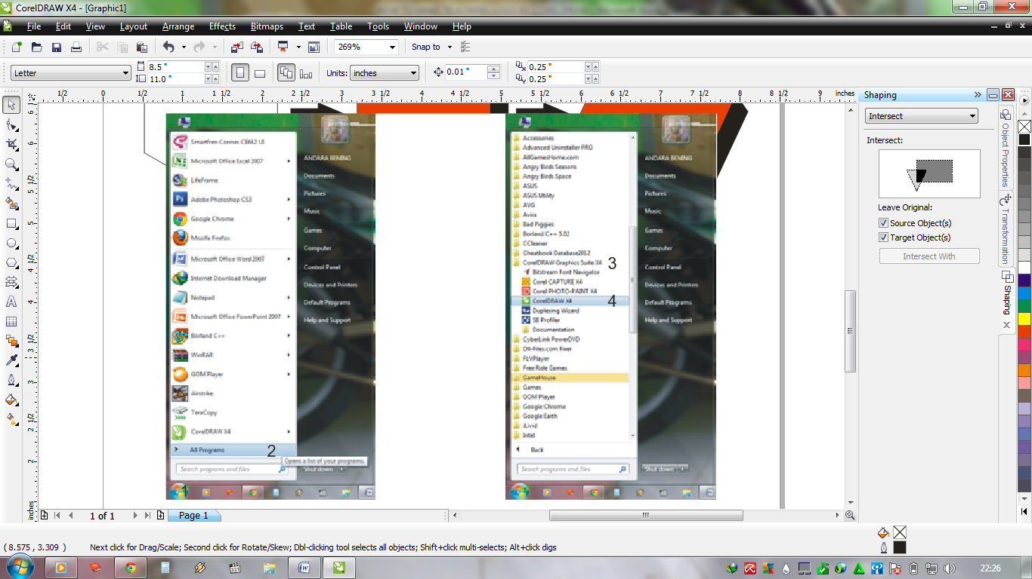
HOW TO MAKE TELKOMSEL LOGO BY COREL DRAW
In this tutorial we will try to make telkomsel logo using Corel Draw X4 software, the following steps by steps :
1. Run your Corel Draw, klik Start > All Program > Klik CorelDRAW Graphic Suite X4 > Then choose CorelDRAW X4.
BACK
NEXT

Slide 3
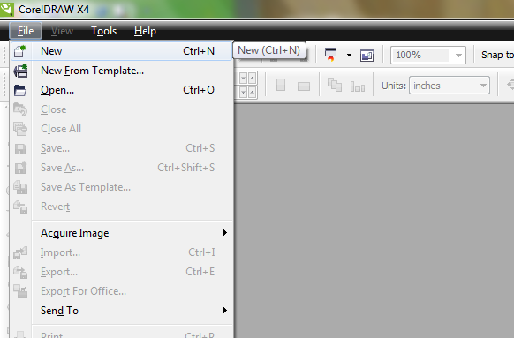
HOW TO MAKE TELKOMSEL LOGO BY COREL DRAW
2. Then create new project, Klik File > New or using key Ctrl+N.
BACK
NEXT

Slide 4
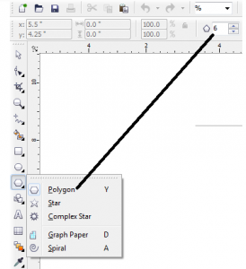
HOW TO MAKE TELKOMSEL LOGO BY COREL DRAW
3. Selecting Polygon Tool or klik key Y, create a hexagon object and press the ctrl button to make a symmetrical hexagon, please insert number 6 into the property bar value.
BACK
NEXT

Slide 5
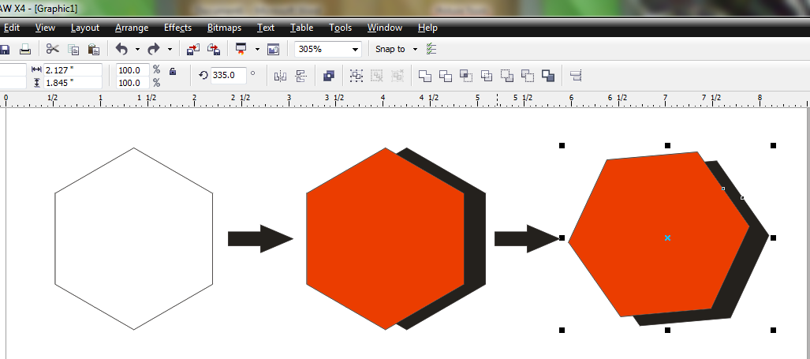
HOW TO MAKE TELKOMSEL LOGO BY COREL DRAW
4. Copy the hexagonal and colouring with red and black then rotate to about 335 degress, as shown below.
BACK
NEXT

Slide 6
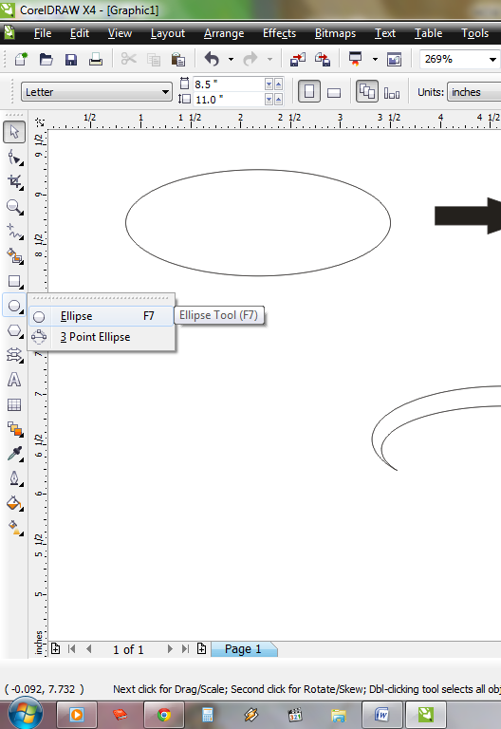
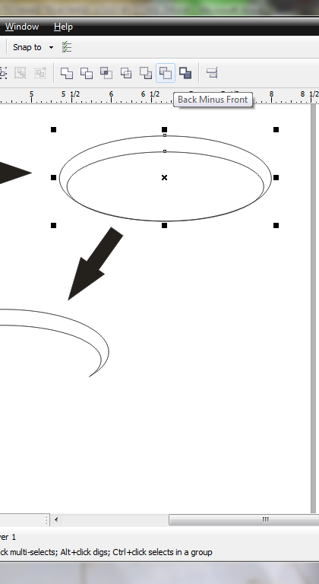
HOW TO MAKE TELKOMSEL LOGO BY COREL DRAW
5. Now create a new circle object around that object, we will use Ellipse Tool (F7), make it a little bit oval shape horizontally then doubled the new object and place it onto the first circle object but with different size (this one is smaller). Then, select both of the circle object and select Back Minus Front, the picture will be shown below.
BACK
NEXT

Slide 7
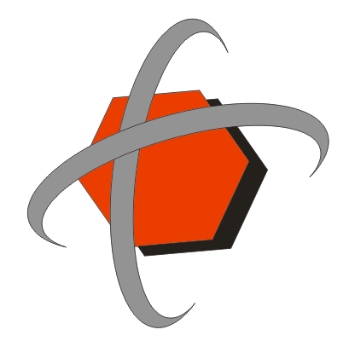
HOW TO MAKE TELKOMSEL LOGO BY COREL DRAW
6. Place the circle onto hexagon created previously then doubled it as shown below and color the circle object with 40% of black.
BACK
NEXT

Slide 8
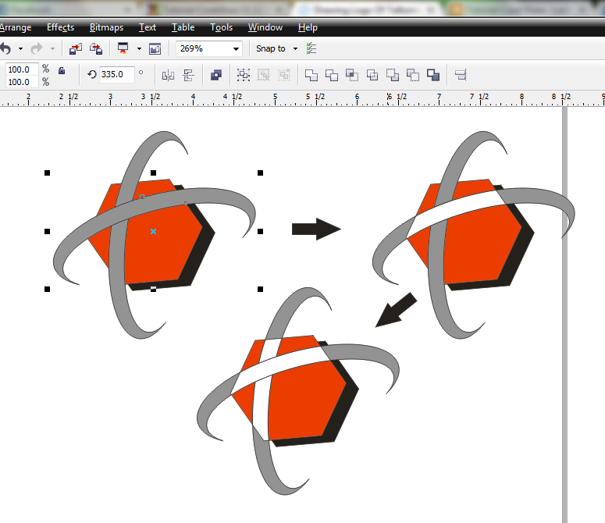
HOW TO MAKE TELKOMSEL LOGO BY COREL DRAW
7. Select the red hexagon, hit the Shift button then select another truncated ellipse, use Intersect method in the property bar. If the property bar doesn’t provide the menu, it can be shown through Arrange – Shaping – Intersect. Color the intersect object with white, do the same thing on the other object intersected between ellipse object and the red hexagon.
BACK
NEXT

Slide 9
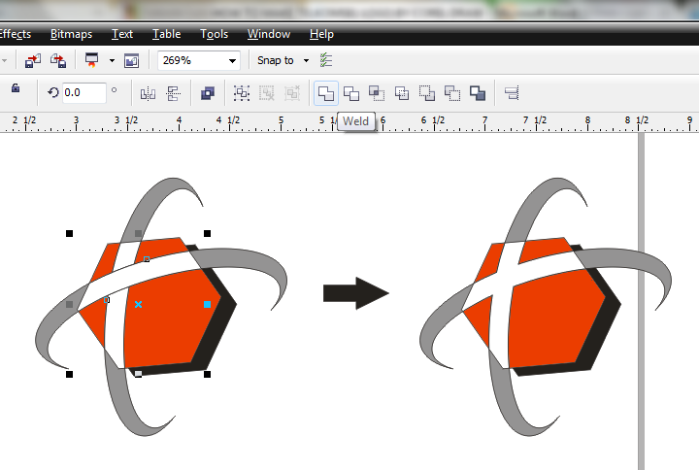
HOW TO MAKE TELKOMSEL LOGO BY COREL DRAW
8. Now we combine the two objects inside the box, select all object and use Weld method in the property bar.
BACK
NEXT

Slide 10

HOW TO MAKE TELKOMSEL LOGO BY COREL DRAW
9. Finally, write the text TELKOMSEL with the format (Arial, Bold, italic) just like the picture shown below.
BACK
NEXT

